Slide 1
ODS (output delivery system)

Slide 2
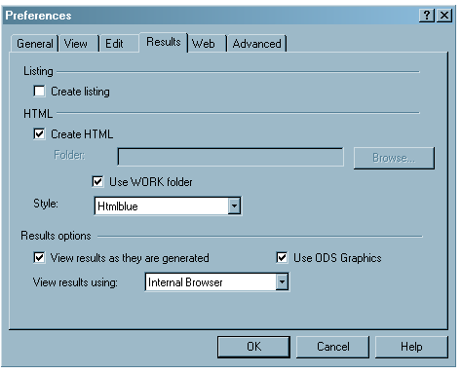
Changing Output Destination (SAS 9.3)
You can view and modify the default settings by selecting Tools⇒ Options ⇒ Preferences from the menu at the top of the main SAS window. Then open the Results tab

Slide 3
General Idea of ODS
Prior to version 7 of SAS output was the results of a SAS procedure and was stored in a basic output file (or output window).
ODS now creates output objects from procedures that have basically three components: data component, table definition (order of columns, rows, etc.), and an output destination (.html, .rtf, etc.)

Slide 4
ODS (OUTPUT Delivery System)
Patient Info
PatID | Age | ICD
1 | 20 | 254.1
2 | 33 | 253.1
3 | 54 | 253.0
PatID,Age,ICD
1,20,254.1
2,33,253.1
3,54,253.0
Title
var1 | Var2 | var3
… | … | …
Arial
Bold
Background
+
+
Data/Results from Procedure
Table Template
Style
template
OUTPUT

Slide 5
Getting ALL Styles
Proc template;
list styles;
run;

Slide 6
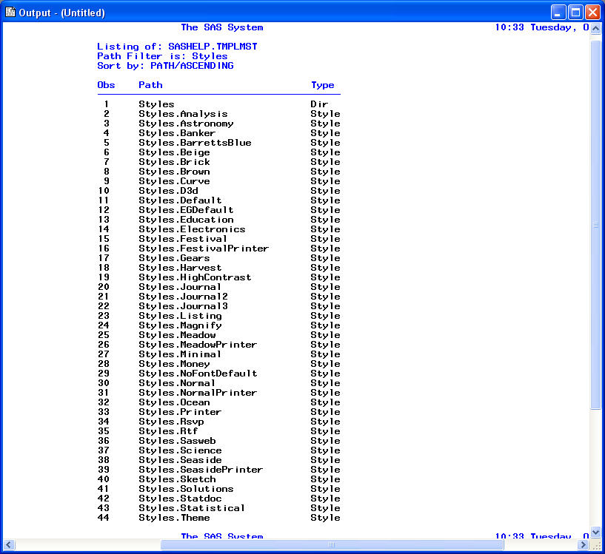

Slide 7
The Output Delivery System (ODS)
enables you to produce output in a variety of formats, such as:
a HTML file (default in SAS 9.4)
a traditional SAS Listing
a PDF file
a PostScript file
an RTF file (for use with Microsoft Word)
Tagsets.EXCELXP (Microsoft EXCEL)
an output data set
Document
ODS also enables you to customize your reports by selecting only the results you want to see.

Slide 8
General Syntax
ODS outputstyle destination <options>;
…………..procedure code…………
ODS outputstyle CLOSE;

Slide 9
The Output Delivery System ODS
Data tt;
Set my.test_trauma;
If missing(MRN) then delete;
Run;
ODS RTF file = “c:\tt\test.RTF“ style=htmlblue;
PROC means data=tt;
var age;
Class race;
RUN;
ODS RTF CLOSE;

Slide 10
Output Delivery System ODS
Data tt;
Set my.test_trauma;
If missing(MRN) then delete;
Run;
ODS PDF file = “c:\test.PDF“ style=science;
PROC means data=tt;
var age;
Class race;
RUN;
ODS PDF CLOSE;

Slide 11
Output Delivery System ODS
Data tt;
Set my.test_trauma;
If missing(MRN) then delete;
Run;
ODS html file = “c:\temp\test.htm“ style=HTMLBlue;
PROC means data=tt;
var age;
Class race;
RUN;
ODS html CLOSE;

Slide 12
Switch between OUTPUT and ODS
/* no output goes into the output window */
ODS listing close;
ODS html file = “c:\temp\test.htm“ style=HTMLBlue;
PROC means data=tt;
var age;
Class race;
RUN;
ODS html CLOSE;
ODS listing;
/* output into the output window */

Slide 13
What about Graphics?
Works the same way as any other procedure although, the sizing of your graph probably won’t be what you want, ODS fits output to 8½” x 11”.
For html output you need to specify a path for your graphics, generally the same path as where you put your other html files, add the following line to your opening ODS line:
gpath = “path-name” (i.e. gpath=“C:/sasclass/”)

Slide 14
Output Delivery System ODS and ODS Graphics
ods rtf file = “c:\temp\test.rtf“;
ods graphics on;
PROC freq;
Table vdayr/chisq;
RUN;
ODS GRAPHICS OFF;
ODS rtf CLOSE;

Slide 15
The Output Delivery System ODS and ODS Graphics
ODS RTF path = "C:\temp"
file = “test.rtf“ style=science
SGE=on;
ods graphics on;
PROC freq;
Table vdayr/chisq;
RUN;
ODS GRAPHICS OFF;
ODS RTF CLOSE;
Ods graphics

Slide 16
Only WORD RTF OUTPUT
title1 '--2004 CDC emergency Room Visits';
ODS listing close;
ODS RTF path = “f:\” file = "test.rtf“ style=analysis;
ODS graphics on;
PROC freq;
Table arrtime/chisq;
RUN;
proc sgplot ;
Histogram tempf;
run;
Proc sgplot;
vbar vdayr;
Run;
ODS graphics off;
ODS rtf CLOSE;
ods listing;

Slide 17
The Output Delivery System ODS
Simple PDF format;
title1 '--2004 CDC emergency Room Visits';
ODS listing close;
ods pdf file = “C:\test.pdf“ style=analysis;
PROC freq;
Table arrtime/chisq;
RUN;
Proc sgplot;
vbar vdayr;
Run;
ODS pdf CLOSE;
ods listing;

Slide 18
Four Types of HTML Output Files
When you use the ODS HTML statement, you can create output that is formatted in HTML. You can browse the output files with Internet Explorer, Netscape, or any other browser that fully supports the HTML 3.2 tag set.
The ODS HTML statement can create four types of HTML files:
a body file that contains the results of the DATA step or procedure
a table of contents that links to items in the body file
a table of pages that links to items in the body file
a frame file that displays the results of the procedure or DATA step, the table of contents, and the table of pages
The body file is required with all ODS HTML output. If you do not want to link to your output, then creating a table of contents, a table of pages, and a frame file is not necessary.

Slide 19
HTML not so simple
ods listing close;
ods html file='odshtml-body.htm'
contents ='odshtml-TOC.htm'
page ='odshtml-page.htm'
frame ='odshtml-frame.htm';
proc univariate data=MY.TEST_ER;
var age;
class sex;
title1 'Average age by gender’;
footnote1 '* Emergency room admissions in 2004';
run;
ods html close;
ods listing;

Slide 20
ODS TRACE ON|OFF
ODS TRACE determines whether to write to the SAS log a record of each output object that a program creates. The ON option writes the trace record to the log, and the OFF option suppresses the writing of the trace record.
The trace record has the following components:
Name is the name of the output object.
Label is the label that briefly describes the contents of the output object
Template is the name of the table definition that ODS used to format the output object.
Path shows the location of the output object. In the ODS SELECT statement in your program, you can refer to an output object by name, label, or path.
A trace record is written to the SAS log.

Slide 21
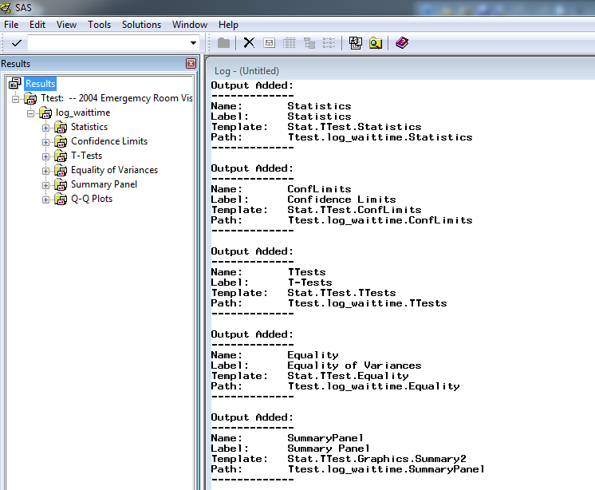

Slide 22
TRACE in LOG
Output Added:
-------------
Name: BasicMeasures
Label: Basic Measures of Location and Variability Template: base.univariate.Measures
Path: Univariate.SATscore.f.BasicMeasures
-------------
Output Added:
-------------
Name: TestsForLocation
Label: Tests For Location Template:
base.univariate.Location Path:
Univariate.SATscore.f.TestsForLocation
-------------
Output Added:
-------------
Name: Quantiles
Label: Quantiles
Template: base.univariate.Quantiles
Path: Univariate.SATscore.f.Quantiles
-------------

Slide 23
Selecting and Excluding Program Output
For each destination, ODS maintains a selection list or an exclusion list.
ODS SELECT output-object(s);
ODS EXCLUDE output-object(s);

Slide 24
Example
ODS rtf file='c:\temp\q5.rtf';
ods trace on;
ods graphics on;
ods select statistics ttests;
proc ttest data=tt;
class paytype;
var log_waittime;
format paytype medicare_aid.;
run;
ods graphics off;
ods trace off;
ods rtf close;

Slide 25
Example of Output Dataset
ODS output Moments=test_moments;
Proc univariate data=my.test_liver_new;
Var r_age;
Run;
ODS output close;

Slide 26
ODS GRAPHICS
You don’t have to activate ODS GRAPHICS ON; for the following graphics procedures:
SGPLOT
SGPANEL
SGSCATTER
SGRENDER

Slide 27
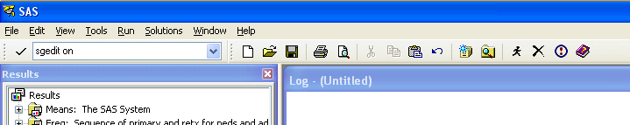
ODS Graphics Editor
The ODS Graphics Editor enables you to edit your SAS graphs
The editable graph has to be in the “SGE” format
You have to activate the SAS Graphics editor first by:
Go to the upper left corner command box and enter
You can now right click a graph in the result window and choose edit

Slide 28
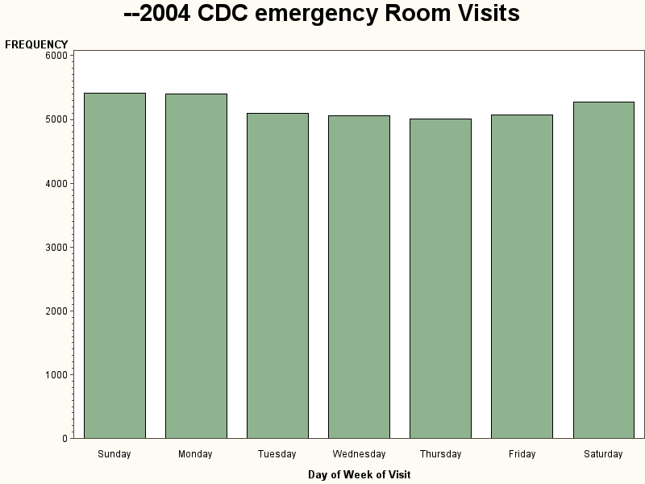
Block Chart
Ods rtf file=‘c:\temp\ttest1.rtf’ sge=on;
Proc sgplot
vbar vdayr;
Run;

Slide 29
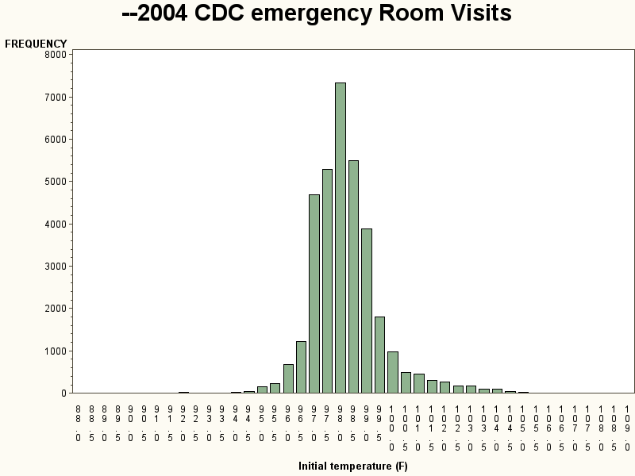
Proc GCHART/Histograms
proc gchart ;
vbar tempf;
run;

Slide 30
PROC SGPLOT
Scattergram Proc sgplot data=test_liver; scatter x=hght_cm y=wght_kg; Run;
Box-Plots proc sgplot data=test_liver;
hbox r_age/category=tx_procedure_type;
run;
Series Plot proc sgplot data=test_liver;
xaxis type=discrete;
series x=tx_year y=tx_cost;
series x=tx_year y=tx_numbr/y2axis;
run;

Slide 31
PROC SGPLOT
Block diagram Proc sgplot data=test_liver; vbar tx_procedure_type;
yaxis label=‘Transplant Type’; Run;
Histogram proc sgplot data=test_liver;
histogram r_age
density r_age;
density r_age/kernel;
run;
Regression plot proc sgplot data=test_liver;
Reg x=wght_kg y=hght_cm;
run;

Slide 32
PROC SGPANEL
Panels graphs
proc sort data=test_liver;
by tx_procedure_type;
Run;
Proc sgpanel data=test_liver;
panelby tx_procedure_type; histogram r_age;
Run;

